Slide 1
The Drunken Tennis Player Problem:
Game Set and Math
By Ian Stewart

Slide 2
SIMPLE EXAMPLE:
Angus and Bethseba take turns to toss a coin
If heads, Angus gets a point
If tails, Bethseba gets a point
First person to get 3 points ahead of the other person wins
There are 10 tosses in total
If neither player has won after 10 tosses, game is a draw
Odds of landing either head/tails is 1/2

Slide 4
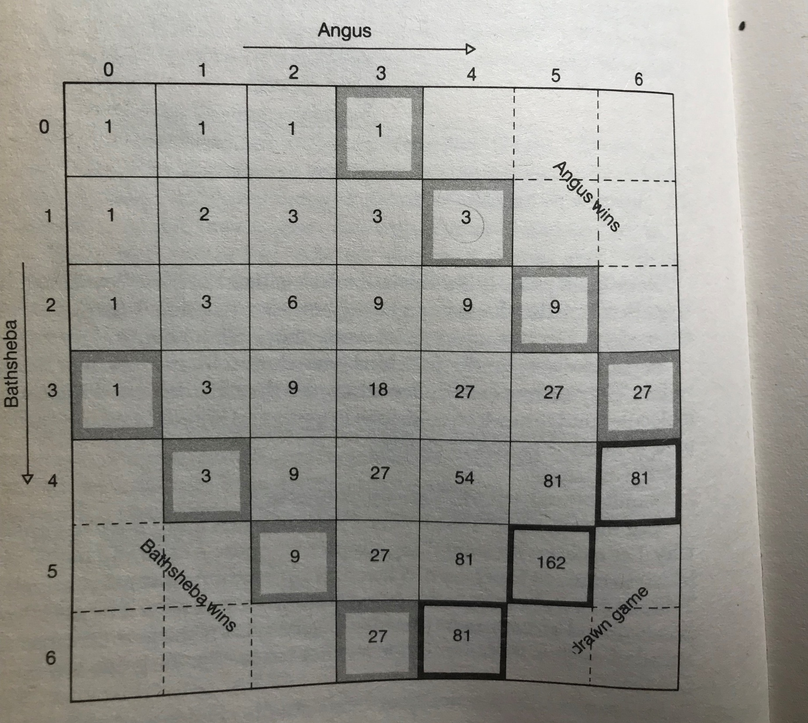

Slide 5
PROBABILITY THEOREM
For a probability set of distinct events you add the individual probabilities
For the probability of 2 independent events happening in turn you multiply probabilities together

Slide 6
RULES FOR 1 GAME OF TENNIS
For 1 game of tennis, you need to win 4 points but the scoring system goes 15, 30, 40, game
If both players get to 3-3 or (40-40) this is called deuce where 1 player needs to get ahead by 2 points in order to win the game
In principle a game could last forever
Probability for Angus to win a point is p=1/3
Probability for Bethseba to win a point is q=2/3

Slide 7
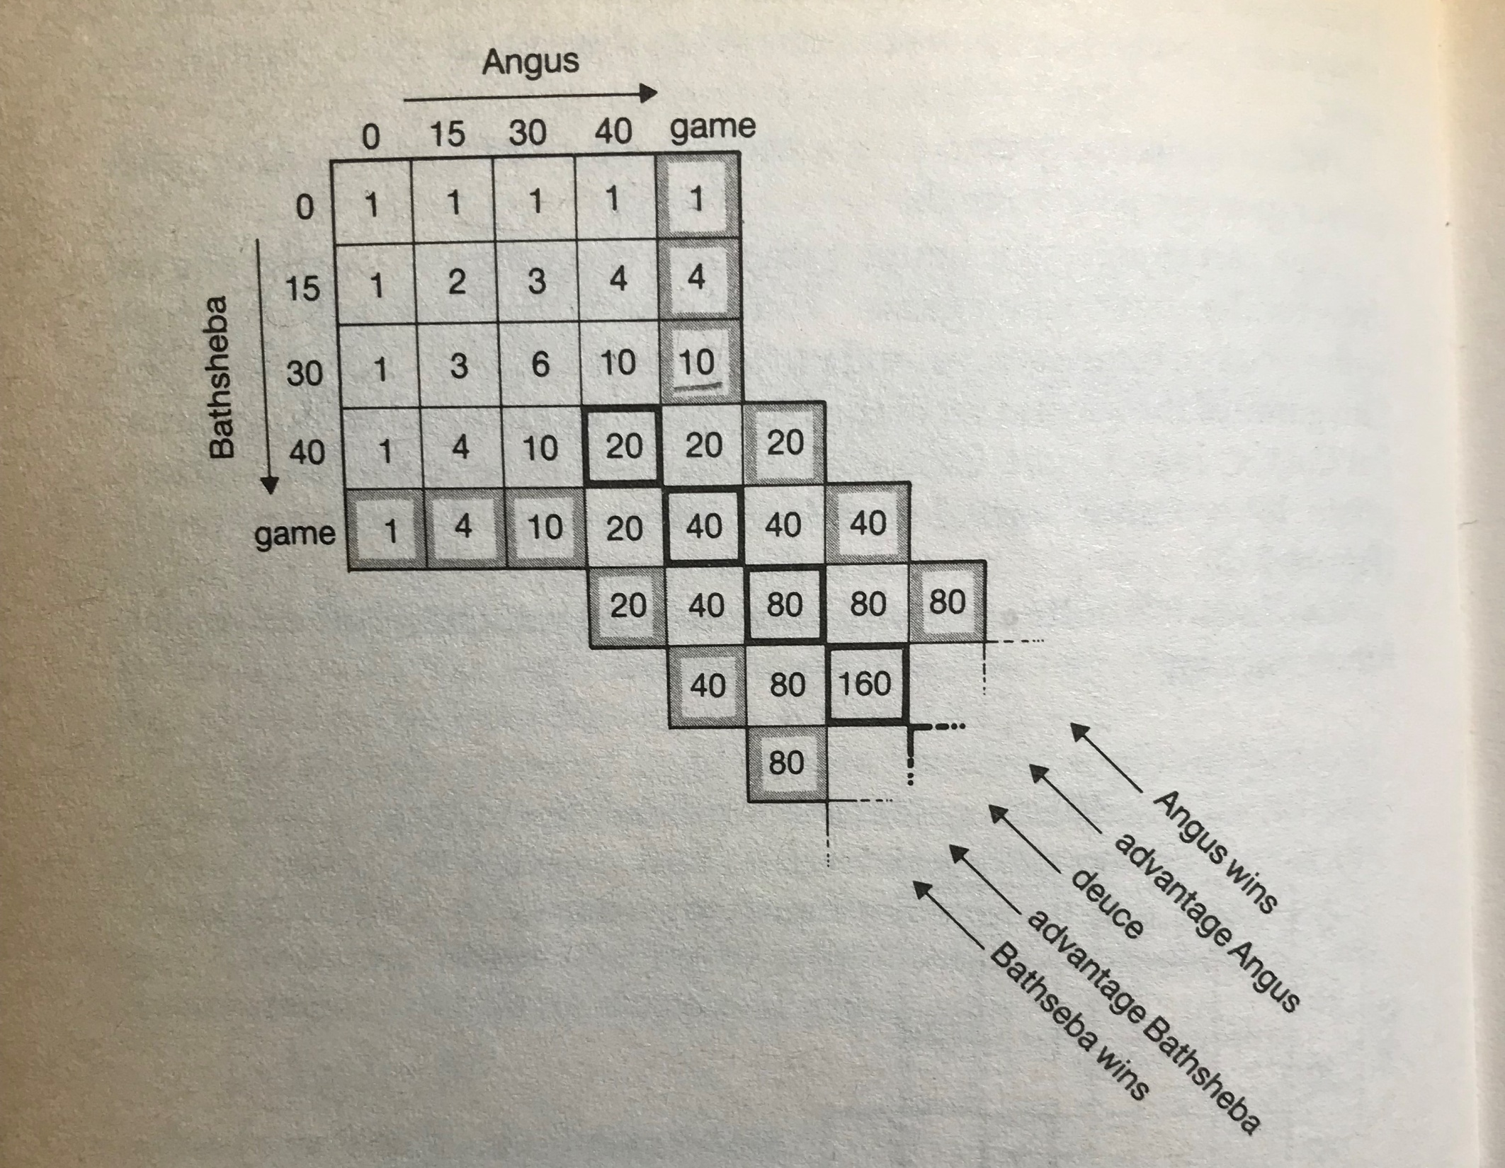

Slide 8
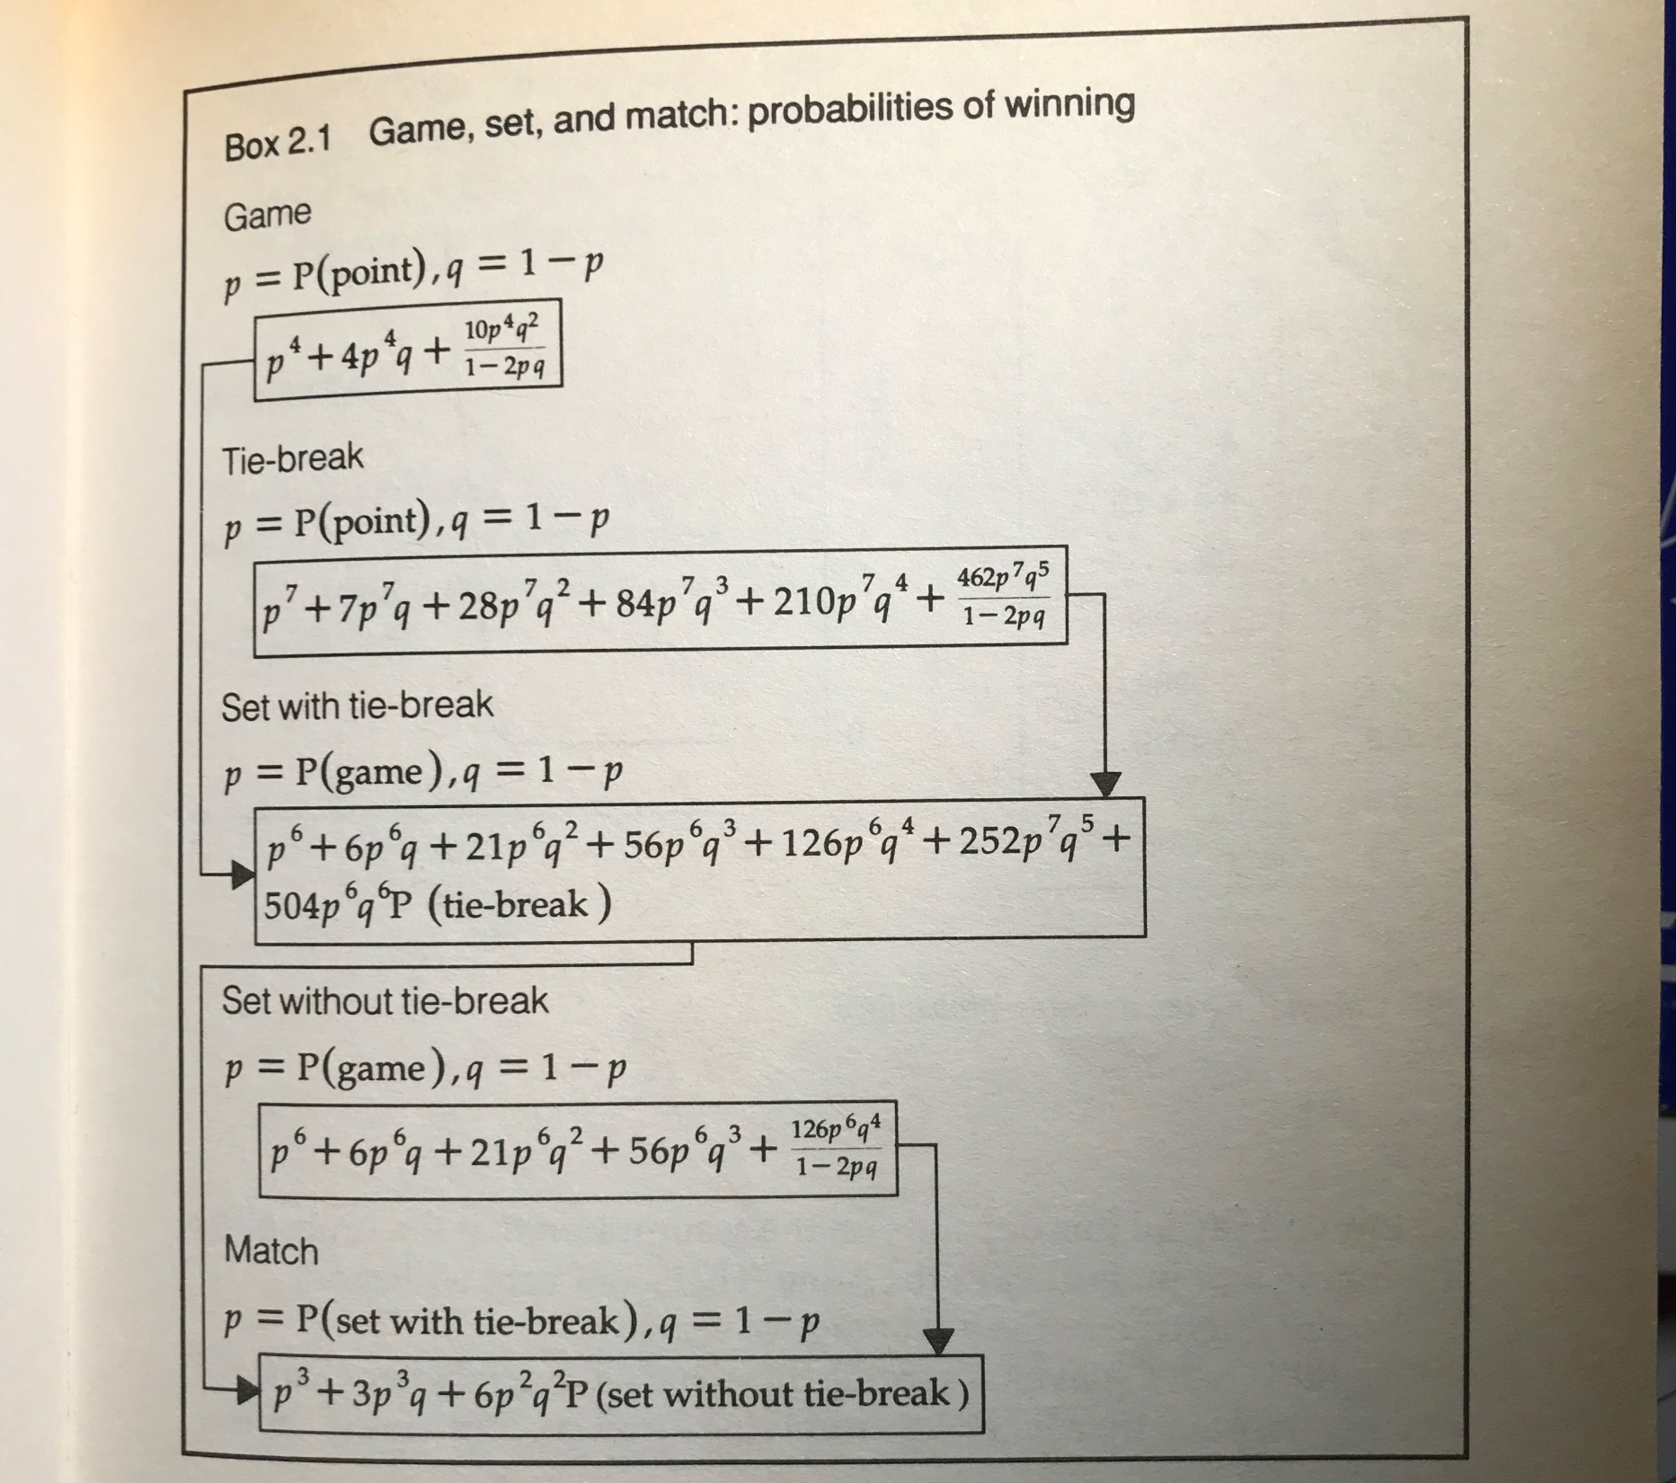

Slide 9
