Slide 1
The magic of multiplication tables

Slide 2
Find the total of all the entries in the 4×4 multiplication table.
1 2 3 4
2 4 6 8
3 6 9 12
4 8 12 16

Slide 3
Find the total of the entries in the 4×4 multiplication table. 1 2 3 4
2 4 6 8
3 6 9 12
4 8 12 16
Why 100?
Is Mathematics about mere answers?
Or structured answers?
100
Or …..
Intelligent guesswork/conjecture depends on
fluency (speed and accuracy – so the brain can focus on thinking)
juggling with, and choosing from, a repertoire of known facts.

Slide 4
Find the total of the entries in the 4×4 multiplication table. 1 2 3 4
2 4 6 8
3 6 9 12
4 8 12 16
100 = 99 + 1?
100 = 5 × 20?
100 = 4 × 25?
100 = 10²?
100 = …?

Slide 5
Find the total of the entries in the 4×4 multiplication table. 1 2 3 4
2 4 6 8
3 6 9 12
4 8 12 16
100 = 10²?
Why 10? …
… Where can I see “10”?
… And is it really “10”? Or …?

Slide 6
Find the total of the entries in the 4×4 multiplication table. 1 2 3 4
2 4 6 8
3 6 9 12
4 8 12 16
100 = 10²?
Why 10? …
… Where can I see “10”?
… And is it really “10”? Or …?
[ASIDE: “1+2+3+4 = 10 demonstrates
how a 10-dim theory
explains the 4 fundamental forces”]

Slide 7
Find the sum of entries in the 10×10 multiplication table.
1 2 3 4 5 6 7 8 9 10
2 4 6 8 10 12 14 16 18 20
3 6 9 12 15 18 21 24 27 30
4 8 12 16 20 24 28 32 36 40
5 10 15 20 25 30 35 40 45 50
6 12 18 24 30 36 42 48 54 60
7 14 21 28 35 42 49 56 63 70
8 16 24 32 40 48 56 64 72 80
9 18 27 36 45 54 63 72 81 90
10 20 30 40 50 60 70 80 90 100
1 + 2 + 3 + ……………….. + 10 = S
10 + 9 + 8 + ……………….. + 1 = S

Slide 8
Find the sum of entries in the n×n multiplication table.
1 2 3 …………………………………. n
2 4 6 …………………………………. 2n
3 6 9 …………………………………. 3n
…………………………………………………………….
…………………………………………………………….
n 2n 3n ………………………………….. n²
1 + 2 + 3 + ……………….. + (n – 1) + n = S
n + (n – 1) + (n – 2) + ……………….. + 2 + 1 = S

Slide 9
Find the sum of entries in the n×n multiplication table.
1 2 3 …………………………………. n
2 4 6 …………………………………. 2n
3 6 9 …………………………………. 3n
…………………………………………………………….
…………………………………………………………….
n 2n 3n ………………………………….. n²
1 + 2 + 3 + ……………….. + (n – 1) + n = S
n + (n – 1) + (n – 2) + ……………….. + 2 + 1 = S
Total = (1 + 2 + 3 + ………. + n)²
= [$\frac{n\left(n+1\right)}{2}]$²

Slide 10
Find the sum of entries in the 4th “reverse L-shape”.
1 2 3 4 | …………………………………. n
2 4 6 8 | …………………………………. 2n
3 6 9 12| …………………………………. 3n
|4 8 12 16| …………………………………. 4n
…………………………………………………………………
…………………………………………………………………
n 2n 3n ……………………………………….. n²
Find the sum of the entries in the k^{th} “reverse L-shape”.

Slide 11
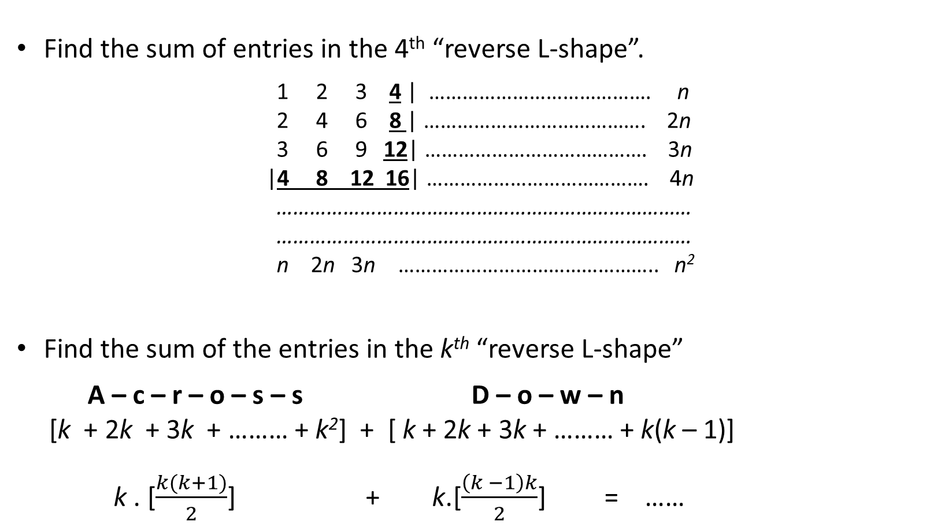
Find the sum of entries in the 4th “reverse L-shape”.
1 2 3 4 | …………………………………. n
2 4 6 8 | …………………………………. 2n
3 6 9 12| …………………………………. 3n
|4 8 12 16| …………………………………. 4n
…………………………………………………………………
…………………………………………………………………
n 2n 3n ……………………………………….. n²
Find the sum of the entries in the k^{th} “reverse L-shape”
A – c – r – o – s – s D – o – w – n
[k + 2k + 3k + ……… + k²] + [ k + 2k + 3k + ……… + k(k – 1)]
k . [$\frac{k(k+1)}{2}$] + k.[$\frac{\left(k −1\right)k}{2}$] = ……

Slide 12
Find the sum of entries in the 4th “reverse L-shape.
1 2 3 4 | …………………………………. n
2 4 6 8 | …………………………………. 2n
3 6 9 12| …………………………………. 3n
|4 8 12 16| …………………………………. 4n
…………………………………………………………………
…………………………………………………………………
n 2n 3n ……………………………………….. n²
Total = (1 + 2 + 3 + ………. + n)²
= [$\frac{n\left(n+1\right)}{2}]$²
= 1³ + 2³ + 3³ + 4³ + ……… + n³
1³ + 2³ + 3³ + ……… + 10³ = ………

Slide 13
S₁ = 1 + 2 + 3 + ………. + n = $\frac{n\left(n+1\right)}{2}$
S₂ = 1² + 2² + 3² + 4² + ……… + n² = ???
S₃ = 1³ + 2³ + 3³ + 4³ + ……… + n³ = [$\frac{n\left(n+1\right)}{2}]$²
Find the sum of entries down the “leading diagonal”.
1 2 3 4 …………………………………. n
2 4 6 8 …………………………………. 2n
3 6 9 12 …………………………………. 3n
4 8 12 16 …………………………………. 4n
………………………………………………………………..
………………………………………………………………..
…………………………………………………………………
…………………………………………………………………
n 2n 3n ……………………………………….. n²

Slide 14
S₂ = 1² + 2² + 3² + 4² + ……… + n² = ???
Find the sum of entries down the diagonal just above the leading diagonal.
1 2 3 4 …………………………………. n
2 4 6 8 …………………………………. 2n
3 6 9 12 …………………………………. 3n
4 8 12 16 …………………………………. 4n
………………………………………………………………..
………………………………………………………………..
…………………………………………………………………
…………………………………………………………………
n 2n 3n ……………………………………….. n²
S = 1.2 + 2.3 + 3.4 + 4.5 + …………… + (n – 1)n
= 1.(1 + 1) + 2(2 + 1) + 3.(3 + 1) + 4.(4 + 1) + ……………… + (n – 1)([n – 1] + 1)
= [1² + 2² + 3² + 4² + …… + (n – 1)²] + [1 + 2 + 3 + 4 + …… + (n – 1)] = S₂(n–1) + S₁(n–1)

Slide 15
S₂ = 1² + 2² + 3² + 4² + ……… + n² = ???
Find the sum of 3×entries down diagonal just above the leading diagonal.
1 2 3 4 …………………………………. n
2 4 6 8 …………………………………. 2n
3 6 9 12 …………………………………. 3n
4 8 12 16 …………………………………. 4n
………………………………………………………………..
………………………………………………………………..
…………………………………………………………………
…………………………………………………………………
n 2n 3n ……………………………………….. n²
3S = 3[1.2 + 2.3 + 3.4 + 4.5 + …………… + (n – 1)n]
6, 24, 60, 120, 210, ……

Slide 16
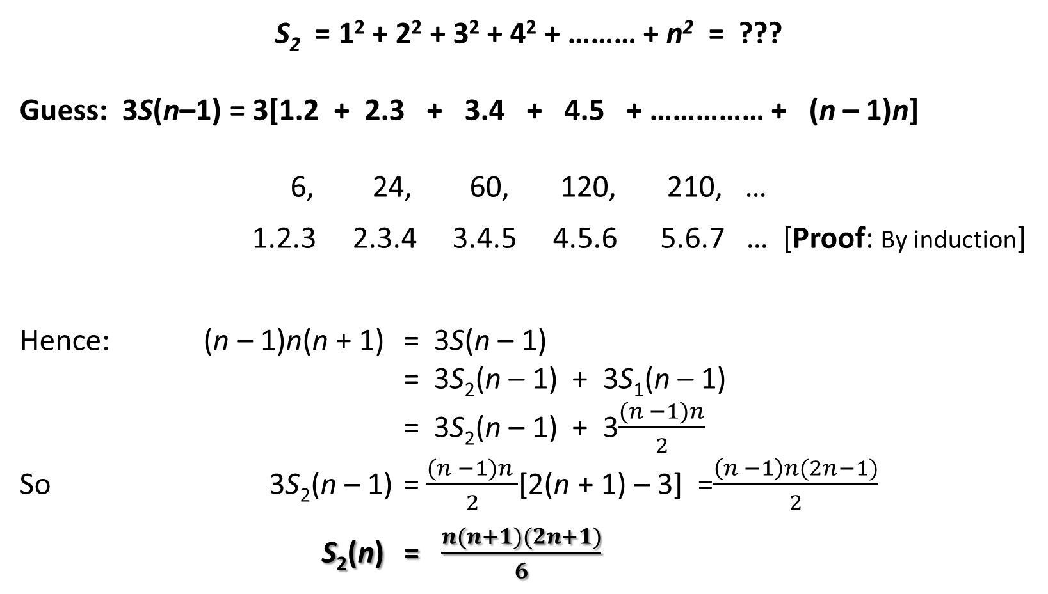
S₂ = 1² + 2² + 3² + 4² + ……… + n² = ???
Guess: 3S(n–1) = 3[1.2 + 2.3 + 3.4 + 4.5 + …………… + (n – 1)n]
6, 24, 60, 120, 210, …
1.2.3 2.3.4 3.4.5 4.5.6 5.6.7 … [Proof: By induction]
Hence: (n – 1)n(n + 1) = 3S(n – 1)
= 3S₂(n – 1) + 3S₁(n – 1)
= 3S₂(n – 1) + 3$\frac{(n −1)n}{2}$
So 3S₂(n – 1) = $\frac{(n −1)n }{2}$[2(n + 1) – 3] =$\frac{\left(n −1\right)n(2n−1)}{2}$
S₂(n) = $\frac{n(n+1)(2n+1)}{6}$

Slide 17
S₂(10) = 1² + 2² + 3² + 4² + ……… + 10²
= ……..
S₂(24) = 1² + 2² + 3² + 4² + ……… + 24²
= ……..

Slide 18
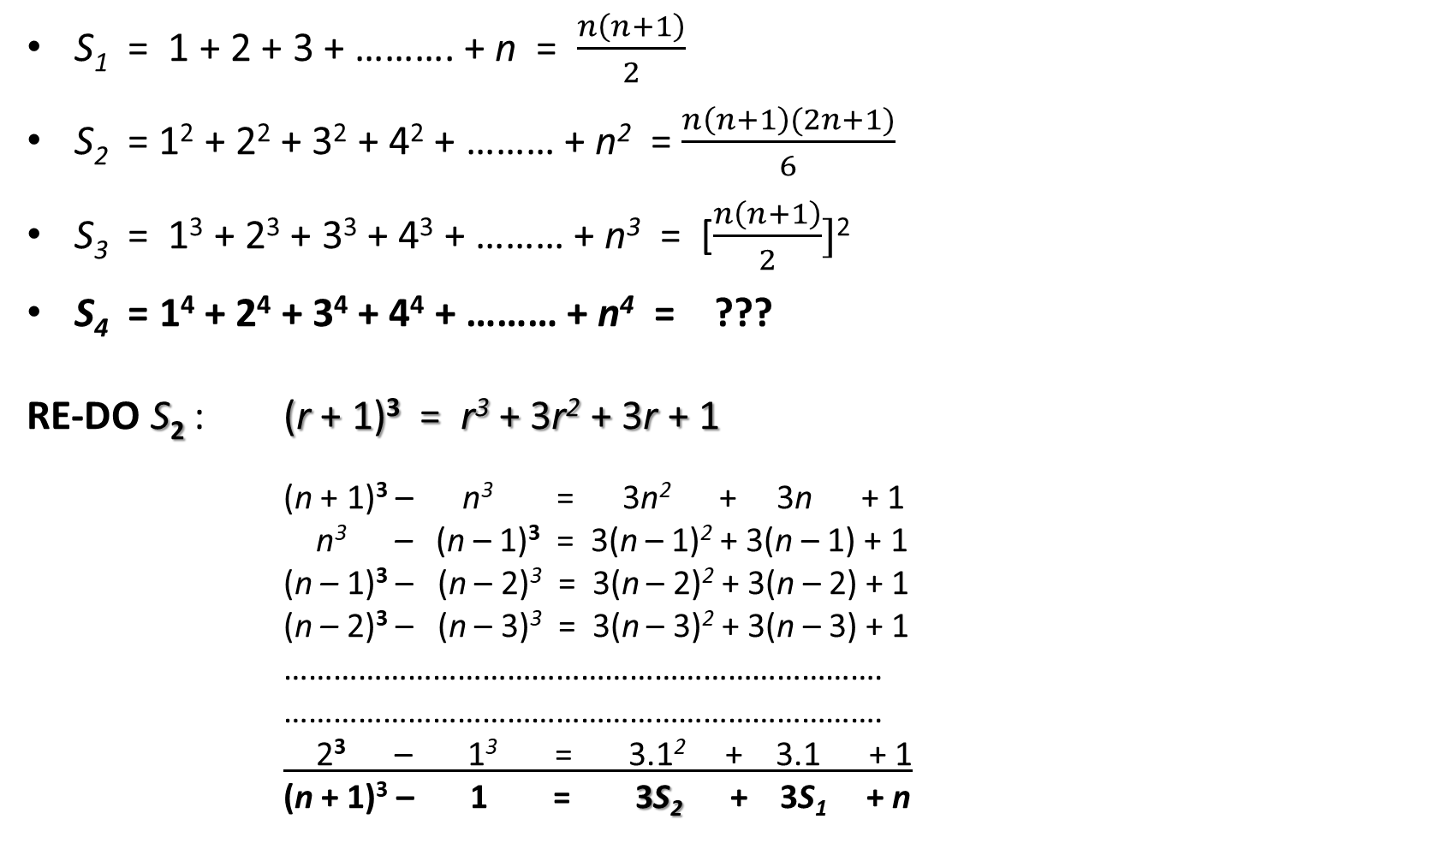
S₁ = 1 + 2 + 3 + ………. + n = $\frac{n\left(n+1\right)}{2}$
S₂ = 1² + 2² + 3² + 4² + ……… + n² = $\frac{n\left(n+1\right)(2n+1)}{6}$
S₃ = 1³ + 2³ + 3³ + 4³ + ……… + n³ = [$\frac{n\left(n+1\right)}{2}]$²
S₄ = 1⁴ + 2⁴ + 3⁴ + 4⁴ + ……… + n⁴ = ???
RE-DO S₂ : (r + 1)³ = r³ + 3r² + 3r + 1
(n + 1)³ – n³ = 3n² + 3n + 1
n³ – (n – 1)³ = 3(n – 1)² + 3(n – 1) + 1
(n – 1)³ – (n – 2)³ = 3(n – 2)² + 3(n – 2) + 1
(n – 2)³ – (n – 3)³ = 3(n – 3)² + 3(n – 3) + 1
……………………………………………………………….
……………………………………………………………….
2³ – 1³ = 3.1² + 3.1 + 1
(n + 1)³ – 1 = 3S₂ + 3S₁ + n

