Slide 1
Mathematical Thinking

Slide 2
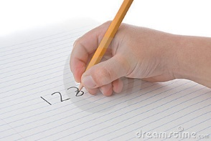
Skills
Processes
1. Simplify
Be Systematic
Be Organised
2. Record
3. Patterns

Slide 3
The story
Flavius Josephus was a Jewish man who live about 2000 years ago
One day his home town of Yodfat was under attack from the Roman army.
Josephus led his army in a brutal, bloody battle, however he was clearly outnumbered and knew defeat was inevitable.
He tried escaping, but the Romans had blocked all exits. Josephus and his men knew the Romans wouldn’t accept their surrender, and there was only one thing left to do.
They would have to kill themselves.
But they couldn’t face killing themselves, so they decide to do it together.

Slide 4
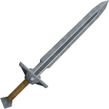
Josephus and his men stood in a circle and decided they would take it in turns to pick up the sword and kill the person next to them
The 1st soldier picked up the sword and killed the 2nd
10
9
1
8
The 3rd then picked up the sword and killed the 4th
2
7
3
The 5th then picked up the sword and killed the 6th
6
5
4
F.J
And so on until there was only one man left. Flavius Josephus
5
Where was he standing?

Slide 5
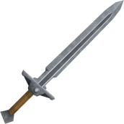
In fact Flavius Josephus had 40 other soldiers with him, but he still knew the correct place to stand.
39
40
41
1
2
3
38
4
37
36
5
35
6
7
34
8
33
9
32
How could he know?
Is there a pattern for any number of people?
10
31
11
30
12
29
13
28
27
14
26
15
25
16
24
18
17
23
22
21
20
19

Slide 6
In fact Flavius Josephus had 40 other soldiers with him, but he still knew the correct place to stand.
39
40
41
1
2
3
38
4
37
36
5
35
6
7
34
Remember what we talked about before
Are you being systematic?
Have you organised your results?
Have you made and tested predictions
8
33
9
32
10
31
11
30
12
29
13
28
27
14
26
15
25
16
24
18
17
23
22
21
20
19

Slide 7
What have you noticed?
Number of people | Safe Position
2
1
3
3
4
1
5
3
6
5
7
7
8
1
9
3
10
5
11
7

Slide 8
What have you noticed?
Number of people | Safe Position
2
1
3
3
4
1
5
3
6
5
7
7
8
1
9
3
10
5
11
7

Slide 9
The rules
Powers of 2 ‘reset’ – (the first person is safe) (2, 4, 8, 16, 32 etc…)
You count up in odd numbers until you reach the next reset
http://alejandroerickson.com/joomla/flash

